Slide 1


How to Generate a High Quality Software System?
Han Yang | Berlin Workshop | 30-07-2025

Slide 2
01
Why we care the Software Quality?
06
OOA Quality Issues
What is the High Quality Software mean?
07
Object-Oriented Design (OOD)
02
How to Generate a High Quality Software System?
08
OOD Quality Issues
03
Case Studies in Object-Oriented Analysis & Design
Implementation Issues
04
09
05
Object-Oriented Analysis (OOA)
10
Tips & Discussion
Notes:
I am sure you will have a lot of questions during our presentation, but because we do not have too much time,
And I will leave several minutes to discussion at the end
We also could discussion later at any time
Then Please do not interupt me during presentation, Thanks !

Slide 3
1 Why we care the Software Quality?
Risk management
Software failure has caused more than inconvenience. Software errors can cause human fatalities.
The Vancouver Stock Exchange index had large errors due to repeated rounding. In January 1982 the index was initialized at 1000 and subsequently updated and truncated to three decimal places on each trade. This was done about 3000 times a day. The accumulated truncations led to an erroneous loss of around 25 points per month. Over the weekend of November 25–28, 1983, the error was corrected, raising the value of the index from its Friday closing figure of 524.811 to 1098.892.
Knight Capital Group lost $440 million in 45 minutes due to the improper deployment of software on servers and the re-use of a critical software flag that caused old unused software code to execute during trading.
The British Post Office scandal; between 2000 and 2015, 736 subpostmasters were prosecuted by the UK Post Office, with many falsely convicted and sent to prison. The subpostmasters were blamed for financial shortfalls which actually were caused by software defects in the Post Office's Horizon accounting software.
A bug in the code controlling the Therac-25 radiation therapy machine was directly responsible for at least five patient deaths in the 1980s when it administered excessive quantities of beta radiation.
etc.

Slide 4
1 Why we care the Software Quality?
Cost management
As in any other field of engineering, a software product or service governed by good software quality costs less to maintain, is easier to understand and can be changed more cost-effectively in response to pressing business needs.
Industry data demonstrate that poor application structural quality in core business applications (such as enterprise resource planning (ERP), customer relationship management (CRM) or large transaction processing systems in financial services) results in cost, schedule overruns and creates waste in the form of rework (see Muda (Japanese term)).
Moreover, poor structural quality is strongly correlated with high-impact business disruptions, including corrupted data, application outages, security breaches, and performance problems.
CISQ reports on the cost of poor quality estimates an impact of:
$2.08 trillion in 2020
$2.84 trillion in 2018
IBM's Cost of a Data Breach Report 2020 estimates that the average global costs of a data breach:
$3.86 million

Slide 5
2. What is Software Quality?
The first definition of quality in recorded history is from Shewhart at the beginning of the 20th century:
"There are two common aspects of quality: one of them has to do with the consideration of the quality of a thing as an objective reality independent of the existence of man. The other has to do with what we think, feel or sense as a result of the objective reality. In other words, there is a subjective side of quality.”[1]
“Quality is a customer determination, not an engineer's determination, not a marketing determination, nor a general management determination. It is based on the customer's actual experience with the product or service, measured against his or her requirements -- stated or unstated, conscious or merely sensed, technically operational or entirely subjective -- and always representing a moving target in a competitive market.”[2]
“Quality is value to some person.”[3][4]

Slide 6
2. What is Software Quality?
ISO 9126 and the subsequent ISO/IEC 25000:
Functionality
Reliability
Usability
Efficiency
Maintainability
Portability
The Consortium for IT Software Quality (CISQ) has defined five major desirable structural characteristics needed for a piece of software to provide business value:
Reliability
Efficiency
Security
Maintainability
Size
Maintainability encompasses concepts such as modularity, understandability, changeability, testability, reusability, and transferability between development teams.

Slide 7
2 What is Software Quality - Size
Several software technical sizing methods have been widely described. The most common technical sizing method is the number of Lines of Code (#LOC) per technology, number of files, functions, classes, tables, etc., from which backfiring Function Points can be computed;
The most common method for measuring functional size is function point analysis. Function point analysis measures the size of the software deliverable from a user's perspective. Function point sizing is performed based on user requirements. It provides an accurate representation of both size for the developer/estimator and value (i.e., the functionality to be delivered), reflecting the business functionality being delivered to the customer. The method includes the identification and weighting of user-recognisable inputs, outputs, and data stores. The size value is then available for use in conjunction with numerous measures to quantify and evaluate software delivery and performance (development cost per function point; delivered defects per function point; function points per staff month).

Slide 8
3 How to High Quality? - Reliability
Application Architecture Practices
Coding Practices
Complexity of algorithms
Complexity of programming practices
Compliance with Object-Oriented and Structured Programming best practices (when applicable)
Component or pattern re-use ratio
Dirty programming
Error & Exception handling (for all layers – GUI, Logic & Data)
Multi-layer design compliance
Resource bounds management
Software avoids patterns that will lead to unexpected behaviours
Software manages data integrity and consistency
Transaction complexity level

Slide 9
3 How to High Quality? - Efficiency
Application Architecture Practices
Appropriate interactions with expensive and /or remote resources
Data access performance and data management
Memory, network and disk space management
Compliance with Coding Practices(Best coding practices)

Slide 10
3 How to High Quality? - Security
Implementation, Management of a security-aware and hardening development process, e.g. Seecurity Development Lifecycle (Microsoft) or IBM‘s Secure Engineering Framework.
Secure Application Architecture Practices
Multi-layer design compliance
Security best practices (Input Validation, SQL Injection, Cross-Site Scripting, Access control etc.)
Secure and good Programming Practices
Error & Exception handling

Slide 11
3 How to High Quality? - Maintainability
Application Architecture Practices
Architecture, Programs and Code documentation embedded in source code
Code readability
Code smells
Complexity level of transactions
Complexity of algorithms
Complexity of programming practices
Compliance with Object-Oriented and Structured Programming best practices (when applicable)
Component or pattern re-use ratio
Controlled level of dynamic coding
Coupling ratio
Dirty programming
Documentation
Hardware, OS, middleware, software components and database independence
Multi-layer design compliance
Portability
Programming Practices (code level)
Reduced duplicate code and functions
Source code file organisation cleanliness

Slide 12
3 How to High Quality? – Programming errors
Reliability
Avoid software patterns that will lead to unexpected behavior (Uninitialized variable, null pointers, etc.)
Methods, procedures and functions doing Insert, Update, Delete, Create Table or Select must include error management
Multi-thread functions should be made thread safe, for instance servlets or struts action classes must not have instance/non-final static fields
Efficiency
Ensure centralization of client requests (incoming and data) to reduce network traffic
Avoid SQL queries that don't use an index against large tables in a loop
Security
Avoid fields in servlet classes that are not final static
Avoid data access without including error management
Check control return codes and implement error handling mechanisms
Ensure input validation to avoid cross-site scripting flaws or SQL injections flaws
Maintainability
Deep inheritance trees and nesting should be avoided to improve comprehensibility
Modules should be loosely coupled (fanout, intermediaries) to avoid propagation of modifications
Enforce homogeneous naming conventions

Slide 13
3 How to High Quality? – Web site
https://riverty.atlassian.net/wiki/spaces/IKAROS/pages/105530230452/High+Quality+Software+System+HQSS
High Quality Software Requirement Analysis
High Quality Software Design
High Quality Software Implementation
High Quality Software Testing
High Quality Continuous Integration and Continuous Deployment
High Quality Software Documentation
High Quality Software Project Management

Slide 14
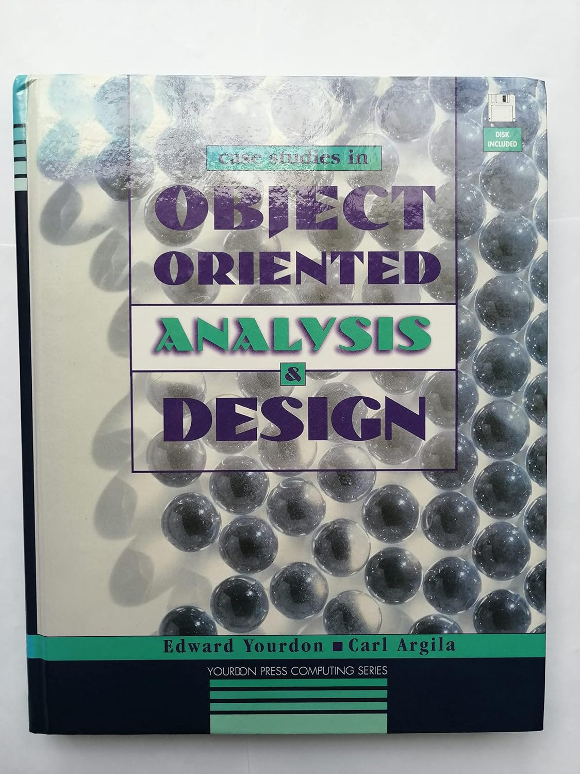
4 Case studies in Object-Oriented Analysis & Design
https://riverty.atlassian.net/wiki/spaces/IKAROS/pages/105530231254/Case+Studies+in+Object-Oriented+Analysis+and+Design
https://www.amazon.de/-/en/Studies-Object-Oriented-Analysis-Yourdon-Computing/dp/0133051374
By Devansvd - Own work, CC BY-SA 4.0, https://commons.wikimedia.org/w/index.php?curid=109591026

Slide 15
4 Case studies in Object-Oriented Analysis & Design – Software development history
In the 1950’s, programs were created using a ad hoc software development approach; each system was a unique, custom-built intellectual product. These software system were difficult to maintain and enhance.
In the 1960’s, waterfall approach, Phases such as requirements analysis, high-level design, detailed design etc. had to be completed before a subsequent phase could begin. The completion of each phase was marked by the delivery of one or more milestone documents. However, despite the more formal approach, large complex software systems were still being delivered over budget, over schedule and not meeting user requirements.
The 1970‘s, model-based software engineering. A complex software system should be built like any large, complex engineering system – by first building working paper models of the system before committing resources to implement it. Users should be able to „visualise living with the system of the future“ before actually going out and building the damned thing!

Slide 16
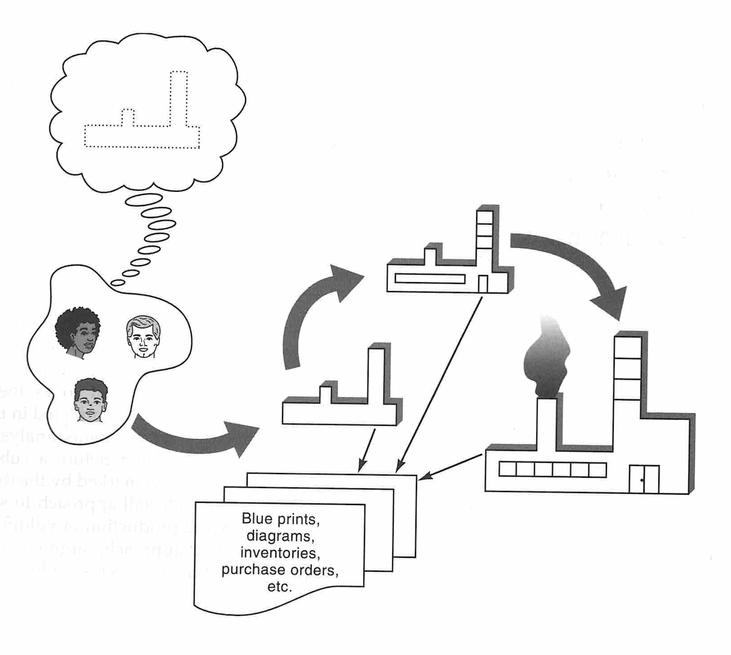
4 Case studies – Separation of Concerns

Slide 17
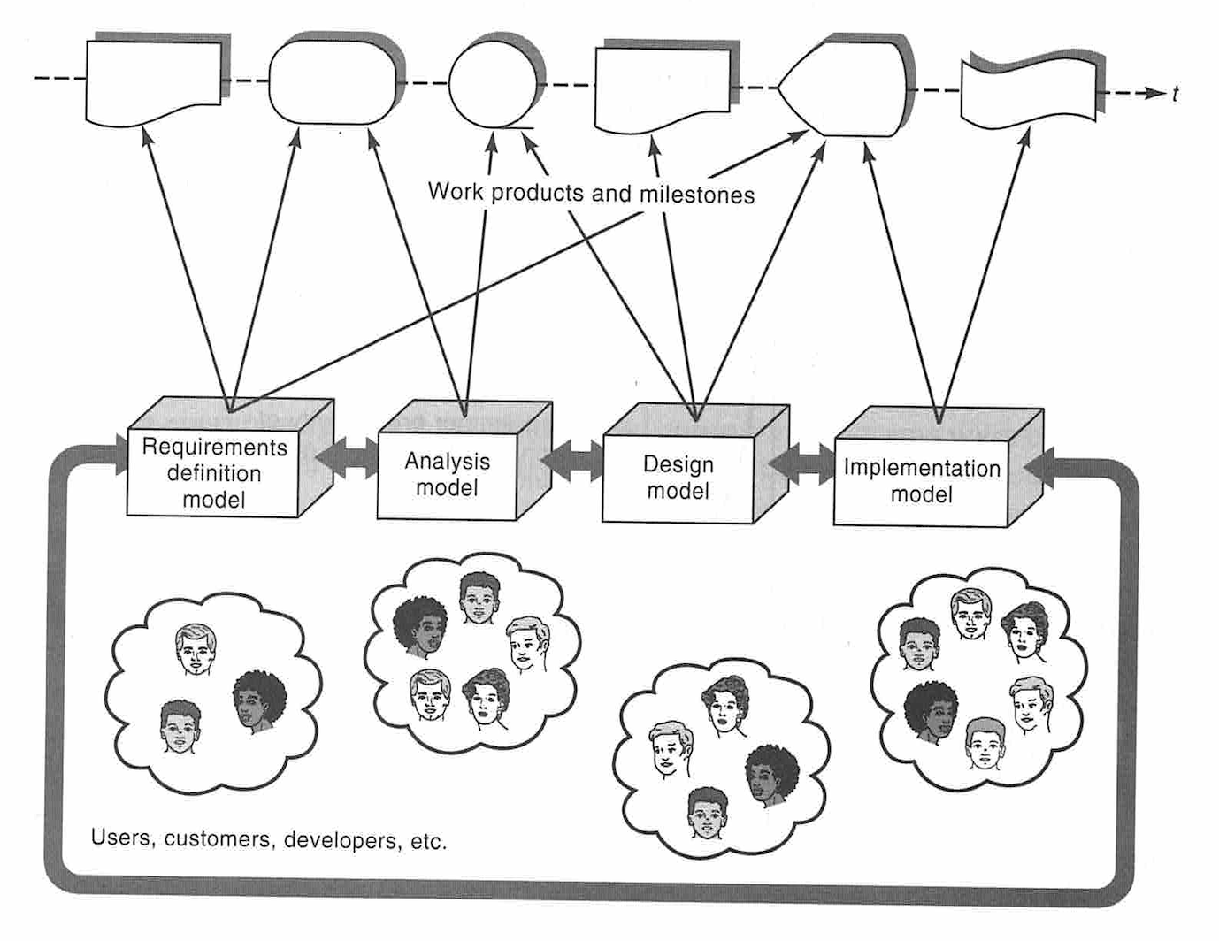
4 Case studies – Separation of Concerns
Analysis models capture software system requirements, which are essential or “logic”, as opposed to implementation-based or “physical” requirements. Analysis models describe what a system will do, independent of any particular implementation approach or technology. Analysis models serve as vehicles of communication between customers, users and developers.
Design models specify how a particular system will be built within the context of a given implementation environment (platform, network, operating system, database, user interface, etc.). Design models serve as vehicles of communication between developers, implementers, testers, etc.

Slide 18
4 Case studies – Object-Orientation
Understandable, so that such a computer program could actually be maintained and enhanced.
Modularised computer programs were, though less efficient, more understandable, extensible and maintainable than large, monolithic computer programs.
Every module corresponds to one and only one thing in the real world.
An object is an independent, asynchronous, concurrent entity which „knows things“(i.e., stores data), „does work“(i.e., encapsulates services) and “collaborates with other objects“(by exchanging messages) to perform the overall functions of the system (being modelled).
Why should I care about objects? The answer is simple- reuse. Although we have been reusing code since the dawn of computers, object-oriented techniques allow us to reuse far more than code. We can reuse requirements, analysis, design, test plans, user interfaces and architectures.

Slide 19
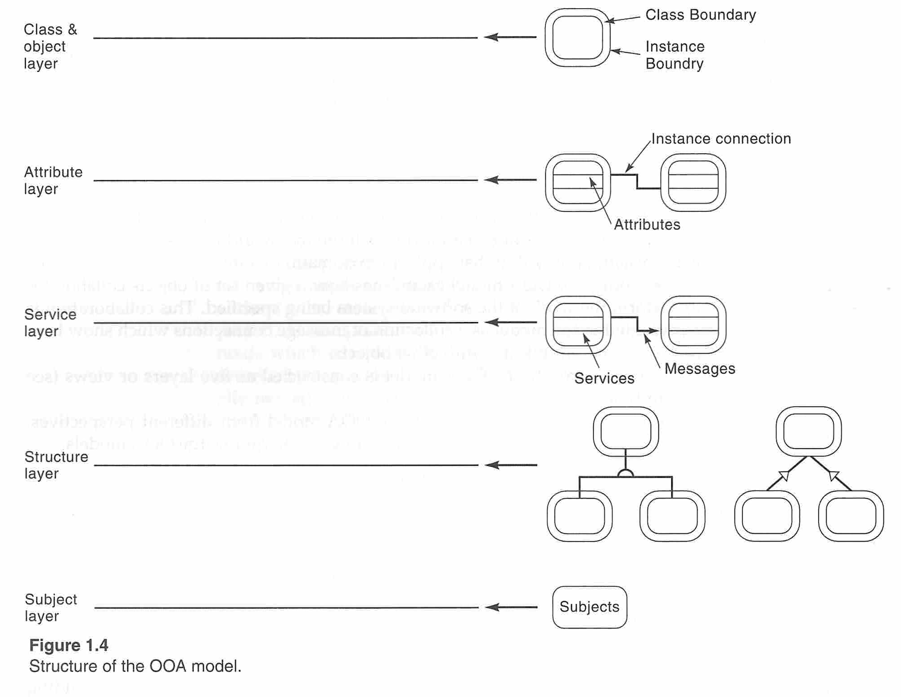
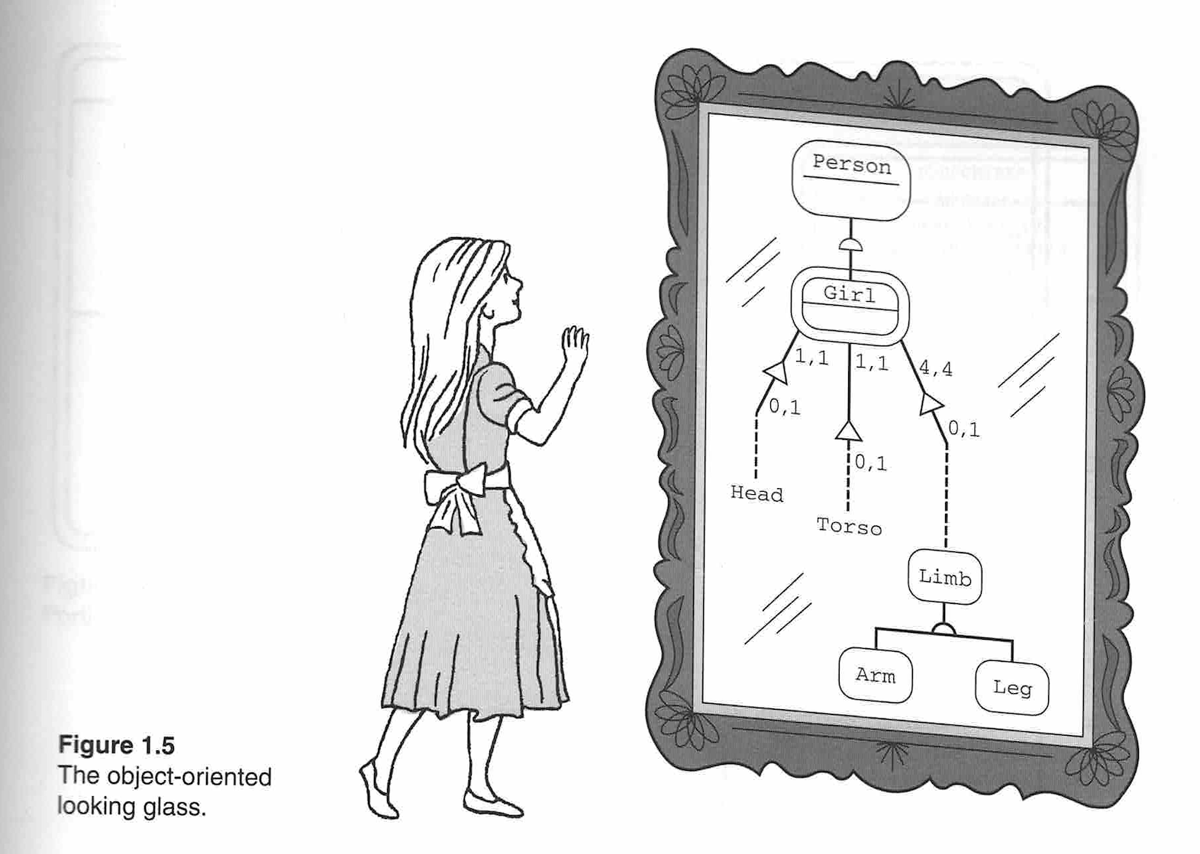
4 Case studies – Object-Oriented Analysis (OOA)

Slide 20
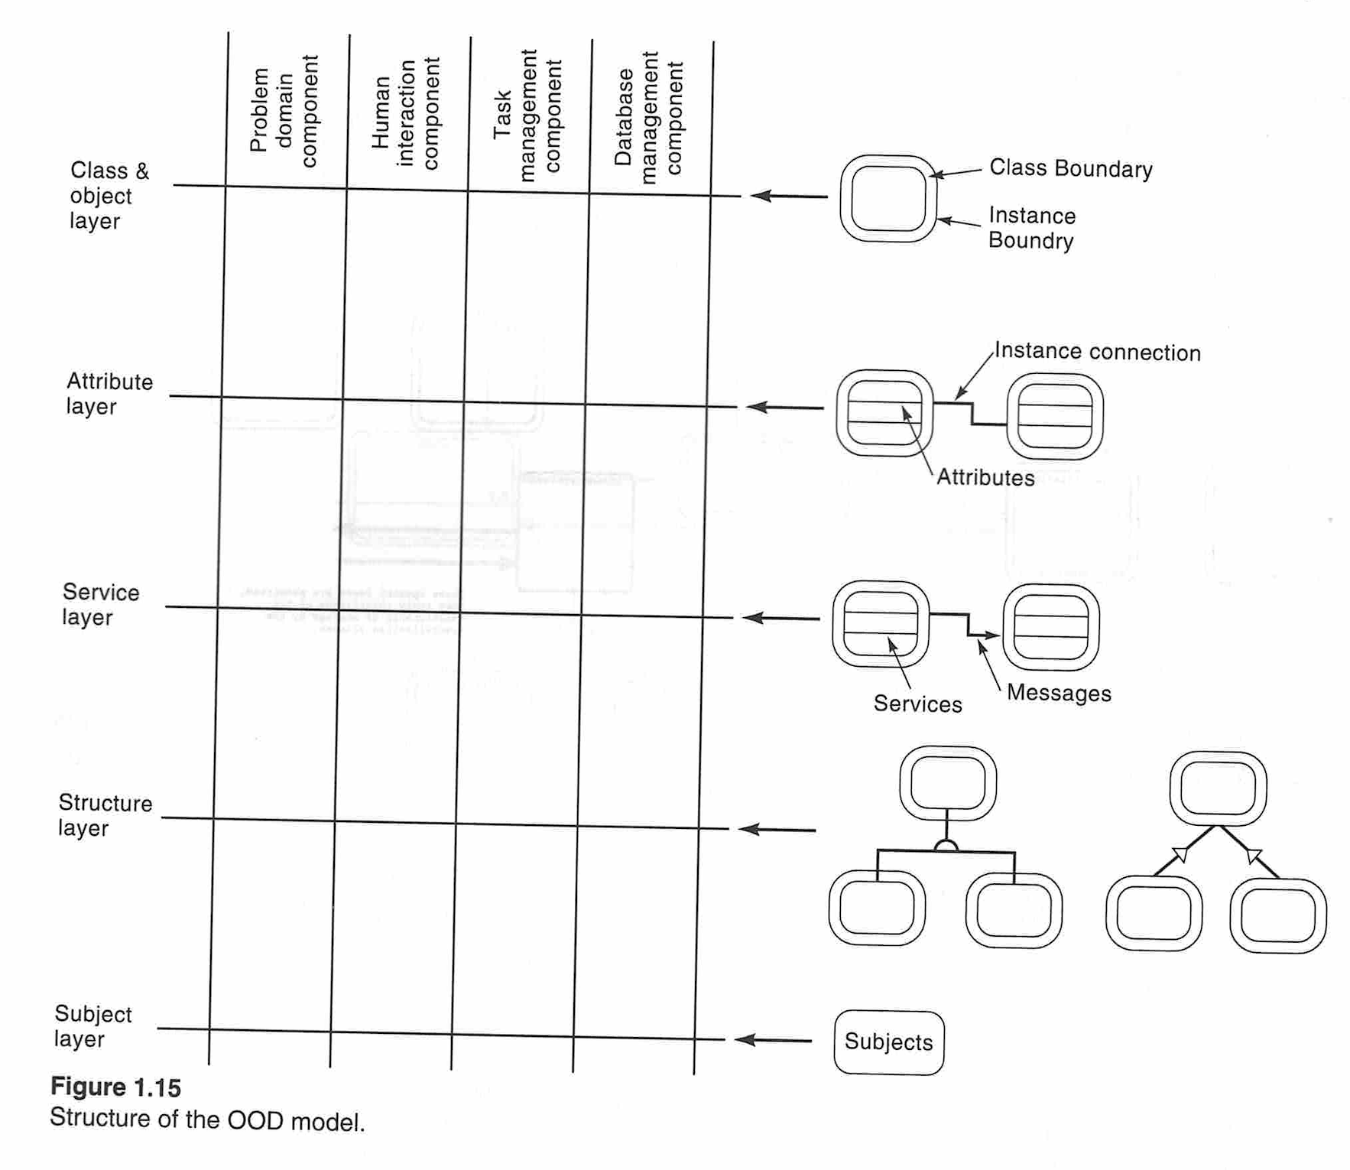
4 Case studies – Object-Oriented Design (OOD)

Slide 21
5. OAuth2 Authorization Grant
Authorization Code with PKCE
Implicit
Resource Owner Password Credentials
Client Credentials

Slide 22
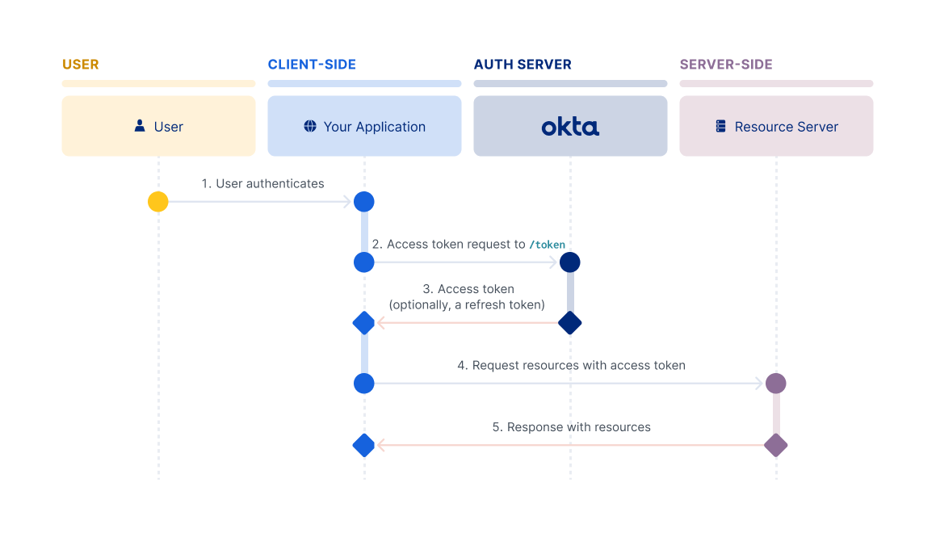
5.1. OAuth2 Authorization Grant - password

Slide 23
5.1. OAuth2 Authorization Grant - password
The Resource Owner Password flow is intended for use cases where:
You control both the client app and the resource that it's interacting with.
The client can store a client secret and can be trusted with the resource owner's credentials.
You don't need your users to use multifactor authentication.
It's most commonly found in first-party clients made for online services, like the Facebook client apps that interact with the Facebook service. It doesn't require redirects like the Authorization Code or Implicit flows, and involves a single authenticated call to the /token endpoint.

Slide 24
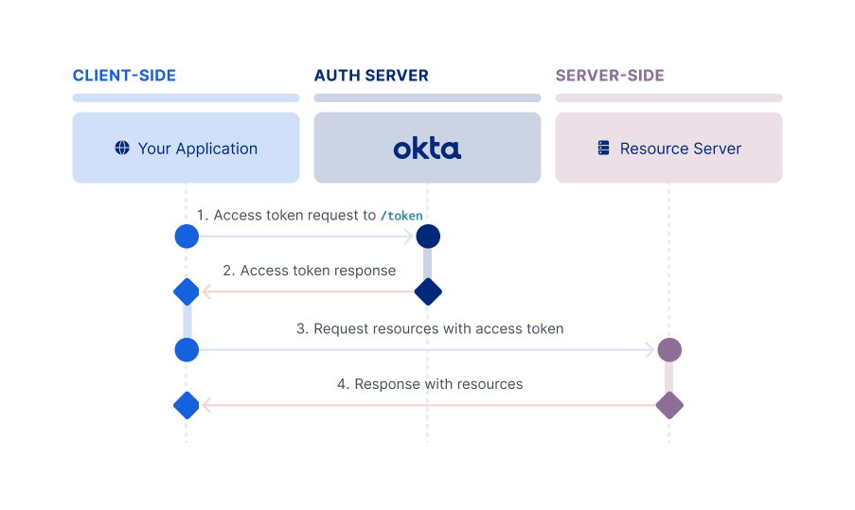
5.2. OAuth2 Authorization Grant – client credential
The Client Credentials flow is intended for server-side (confidential) client apps with no end user. Normally, this means machine-to-machine communication. The app needs to be server-side because it must be trusted with the client secret. Since the credentials are hard-coded, an actual end user can't use it. It involves a single, authenticated request to the /token endpoint, which returns an access token.

Slide 25
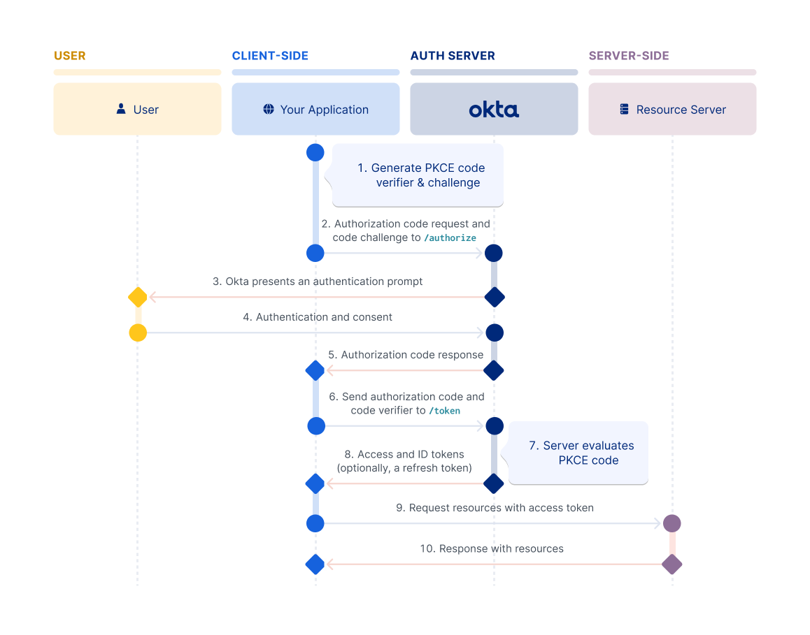
5.3. OAuth2 Authorization Grant – Authorization Code with PKCE

Slide 26
5.3. OAuth2 Authorization Grant – Authorization Code with PKCE
Proof Key for Code Exchange (PKCE) was originally designed as an extension to protect the Authorization Code flow in mobile apps. However, its ability to prevent authorization code injection and keep the flow secure makes it optimal for every type of OAuth client. Okta recommends that you use the Authorization Code flow with PKCE for your OAuth client, if possible.
The flow requires your app to generate a cryptographically random string called a code verifier. The code verifier is then hashed to create the code challenge, and this challenge is passed along with the request for the authorization code. The authorization server responds with an authorization code and associates the code challenge with the authorization code.
After the app receives the authorization code, it sends the authorization code and the code verifier in a request for an access token. The authorization server recomputes the challenge from the verifier using the previously agreed-upon hash algorithm. The authorization server then compares the challenge with the one it associated with the authorization code in the previous step. If the two code challenges and verifier match, the authorization server knows that the same client sent both requests

Slide 27
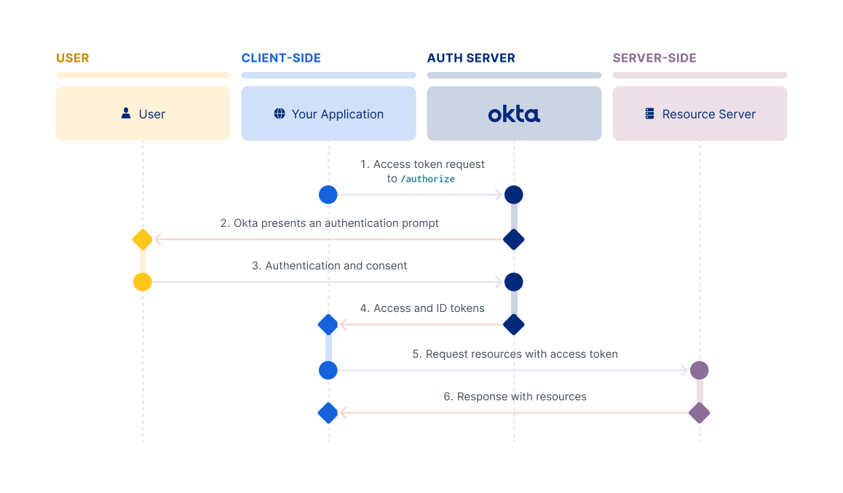
5.4. OAuth2 Authorization Grant - Implicit

Slide 28
5.4. OAuth2 Authorization Grant - Implicit
The Implicit flow is intended for browser-based apps that don't support Cross-Origin Resource Sharing (CORS). This flow is also intended for browser-based apps that lack modern cryptography APIs, and that can't protect a client secret. In this flow, the client doesn't make a request to the /token endpoint, but instead receives the access token in the redirect from the /authorize endpoint. The client must be able to interact with the resource owner's user agent and to receive incoming requests (through redirection) from the authorization server.
Note:
The Implicit flow is a legacy flow used only for SPAs that can't support PKCE.
Because it was always intended for less-trusted clients, the Implicit flow doesn't support refresh tokens.
Important:
For Single-Page apps (SPA) running in modern browsers that support Web Crypto for PKCE, Okta recommends using the Authorization Code flow with PKCE. Use this flow instead of the Implicit flow for maximum security. If support for older browsers is required, the Implicit flow provides a functional solution.

Slide 29
6. Demo one OAuth2 Server – Azure AD

Slide 30
7. Demo OAuth2 Client - Code

Slide 31
8. Demo OAuth2 Client - Postman

Slide 32
9. List OAuth2 Servers
Commercial OAuth 2.0 Providers:
Auth0
Okta
Azure AD
Azure AD B2C
Amazon Cognito
etc
Open Source OAuth 2.0 Servers:
Keycloak - java - enterprise
Hydra (by Ory) – go – microservices architecture
IdentityServer - .net
FusionAuth – java – developer friendly
Authlib – python – lightweight
etc

Slide 33
10. Next Step
Compare the different open source LLM for Relational Database Data
Fine-tune the best open source LLM for Relational Database
Train LLM for NoSQL Database Data

Slide 34
References
Shewart, Walter A. (2015). Economioc control of quality of manufactured product. [Place of publication not identified]: Martino Fine Books. ISBN 978-1-61427-811-5. OCLC 1108913766.
A. V. Feigenbaum, "Total Quality Control", McGraw-Hill, 1983.
Weinberg, Gerald M. (1991). Quality software management: Volume 1, Systems Thinking. New York, N.Y.: Dorset House. ISBN 0-932633-22-6. OCLC 23870230.
Weinberg, Gerald M. (1993). Quality software management: Volume 2, First-Order Measurement. New York, N.Y.: Dorset House. ISBN 0-932633-22-6. OCLC 23870230.
ISO / IEC 9126
ISO /IEC 25000
Consortium for IT Software Quality (CISQ)
List of software bugs

Slide 35
Tips
Lifelong learning
Please consider the depth and width of your knowledge target seriously. Then plan your learning path.
Could we have a software system (such as an AI LLM?) to automate this OOA and OOD process? and why?
3.1 Natural Language Understanding
3.2 Common sense
3.3. Ambiguous / Fuzzy / Contradictory knowledge/requirement

Slide 36
Questions?
Thank You For Attendance!

